Slide 1
FundsBook
Team 16
Luis Diaz, Temuulen Ganbold, Julio Ojalvo

Slide 2
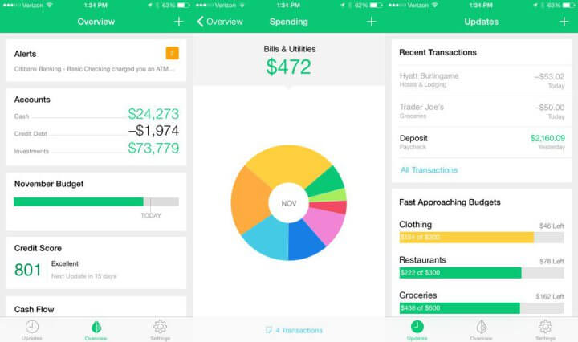
CONCEPT
Social media platform for budgeting and money management
Teach young people what they aren’t taught in high school
Hope to get young people involved in savings
Financial experts can help new users get started

Slide 3
FUNCTIONAL REQUIREMENTS

Slide 4
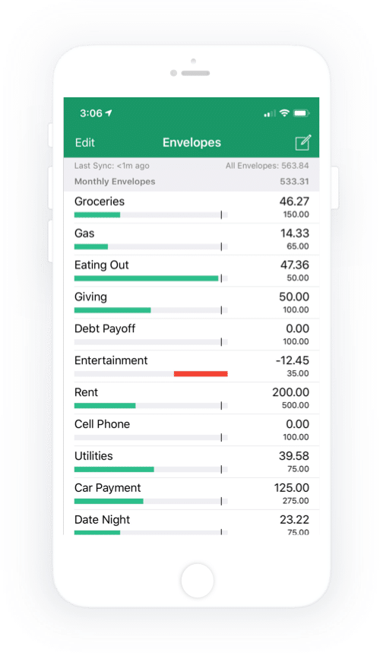
CREATING BUDGET PLANS
Personal
User has the ability to create a personal budget for himself/herself to follow
User can deposit different amounts of money into different budget plans
User can add tags, such as the hashtags on social media to identify what kind of budget plan it is
Auxiliary
Secondary budget plans
Personal or public
Different priorities

Slide 5
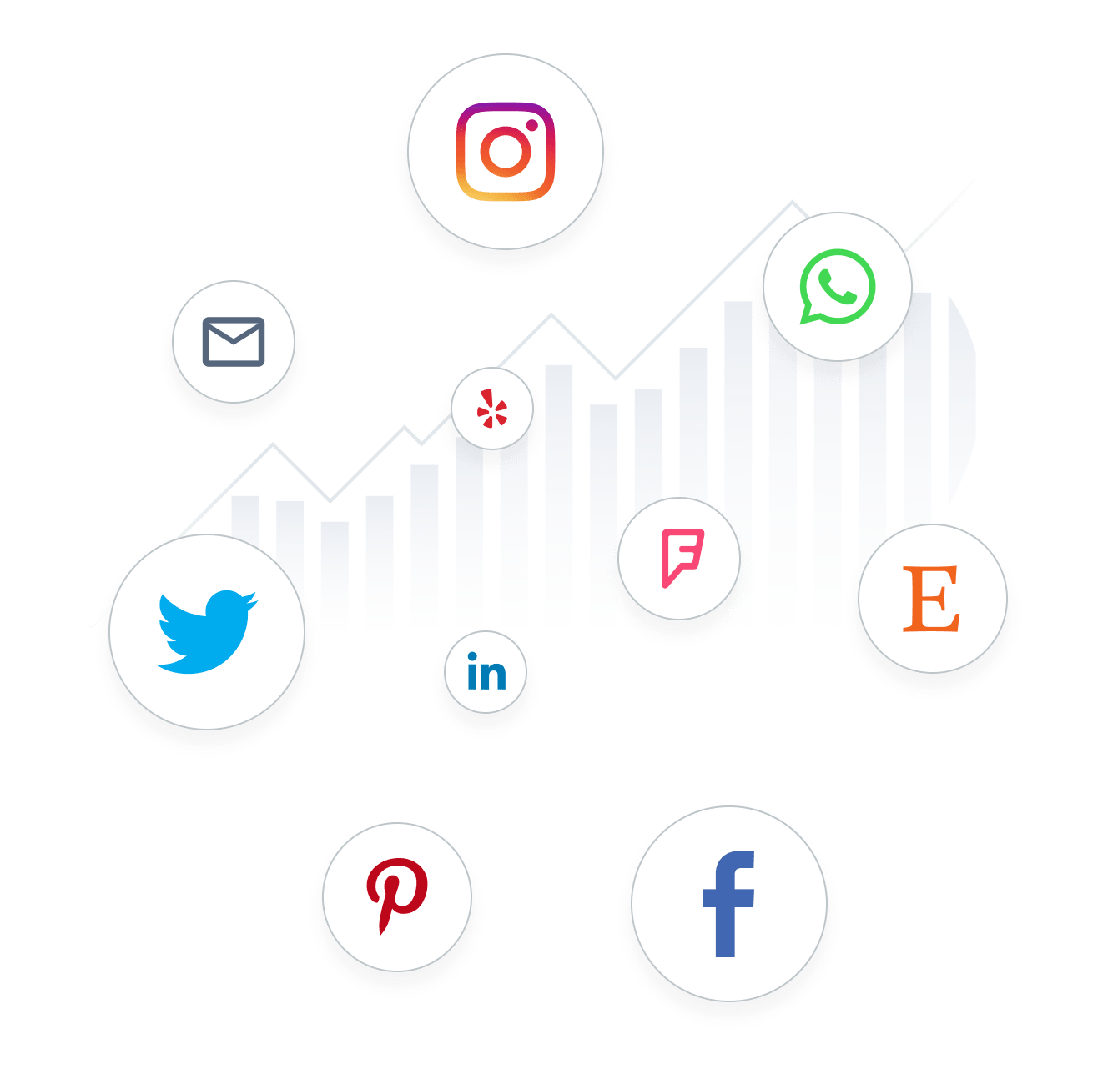
SOCIAL LIFE
Followers
Option to follow other users on the platform
Can see auxiliary budget plans instantly if profile settings are public
Receive notifications from those who a user follows to see any progress/changes made
Friends
App allows those close to you to become “friends” with you on the app
Friends are allowed to see more detailed information
Allows for “friends” to directly message each other on the app
Close Friends
Allows for advanced features such as sharing budget plans only with close friends
Notifications from close friends only

Slide 6
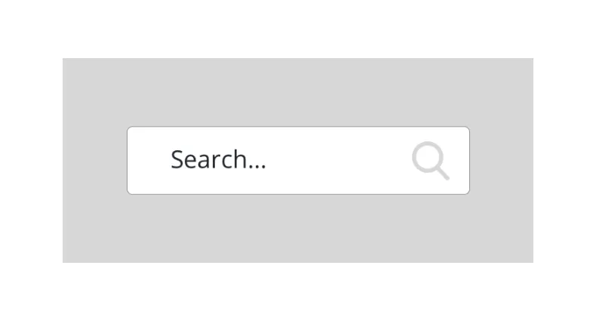
SEARCHING
One of the main tabs is a search bar
Search for specific profiles
Search for certain types of plans based on tags given to them
Hope to personalize usage of the app

Slide 7
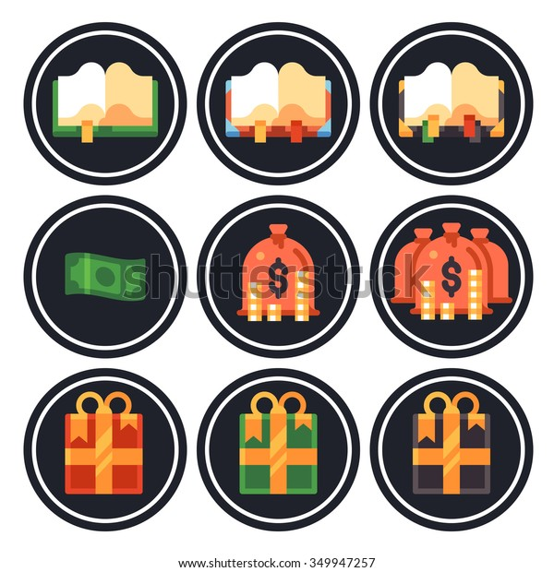
ACHIEVEMENT BADGES
Users receive badges to be displayed on their profile for completing certain goals
Hope to encourage users to keep on their path by rewarding them for:
Following a budget for extended periods of time
Creating certain amount of budget plans
Using certain amounts of unique tags on created budget plans

Slide 8
NON-FUNCTIONAL REQUIREMENTS

Slide 9
INFORMATION ENCRYPTION
All user information will be encrypted or stored locally including:
Username/email
Passwords
Banking information

Slide 10

SUSPICIOUS ACTIVITY DETECTION
Detect suspicious activity and lock the account
App alerts user if account is logged into from an unknown location
Too many failed login attempts will also alert the user
Account is locked until user can verify identity

Slide 11
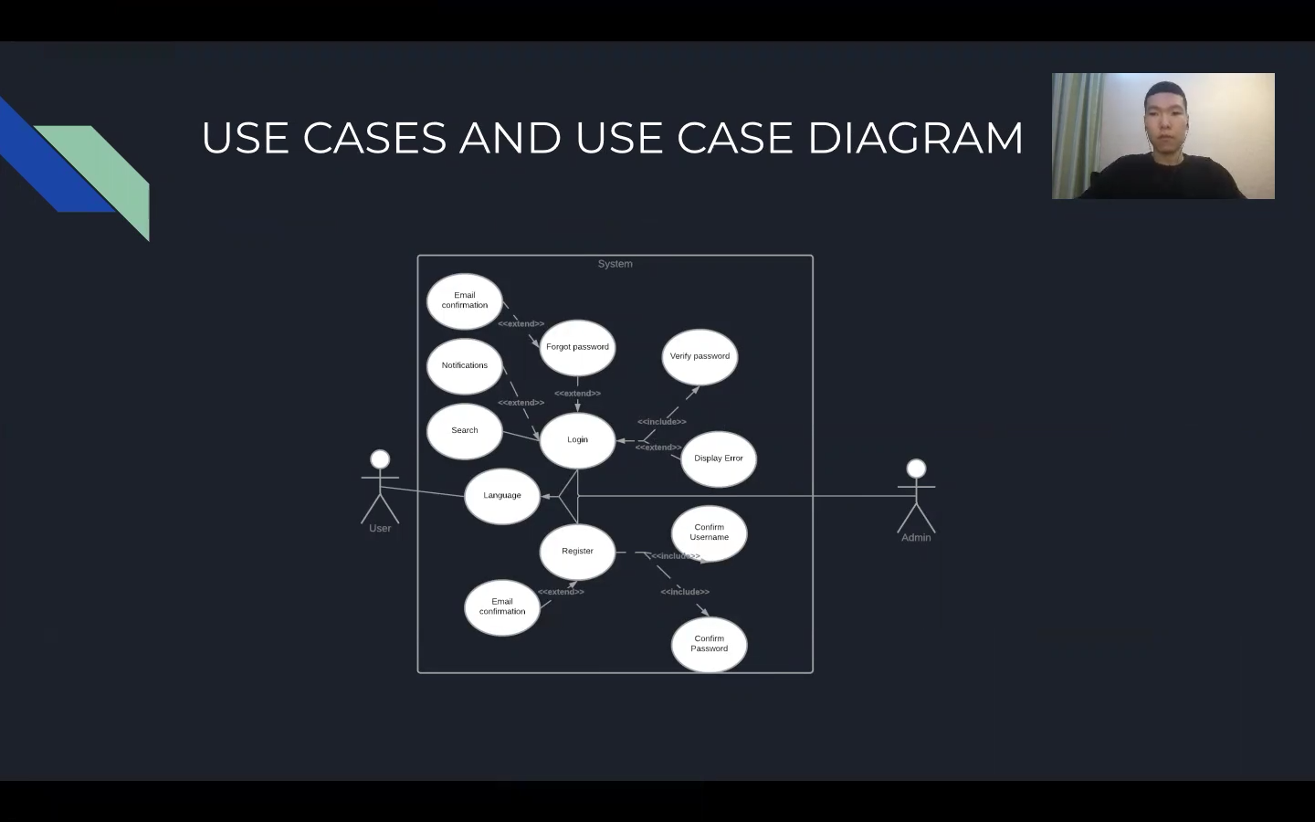

Slide 12
Questions?

